Slide 1
WORLD BNOTES EXCHANGE INC.
Identification Requirements

Slide 2
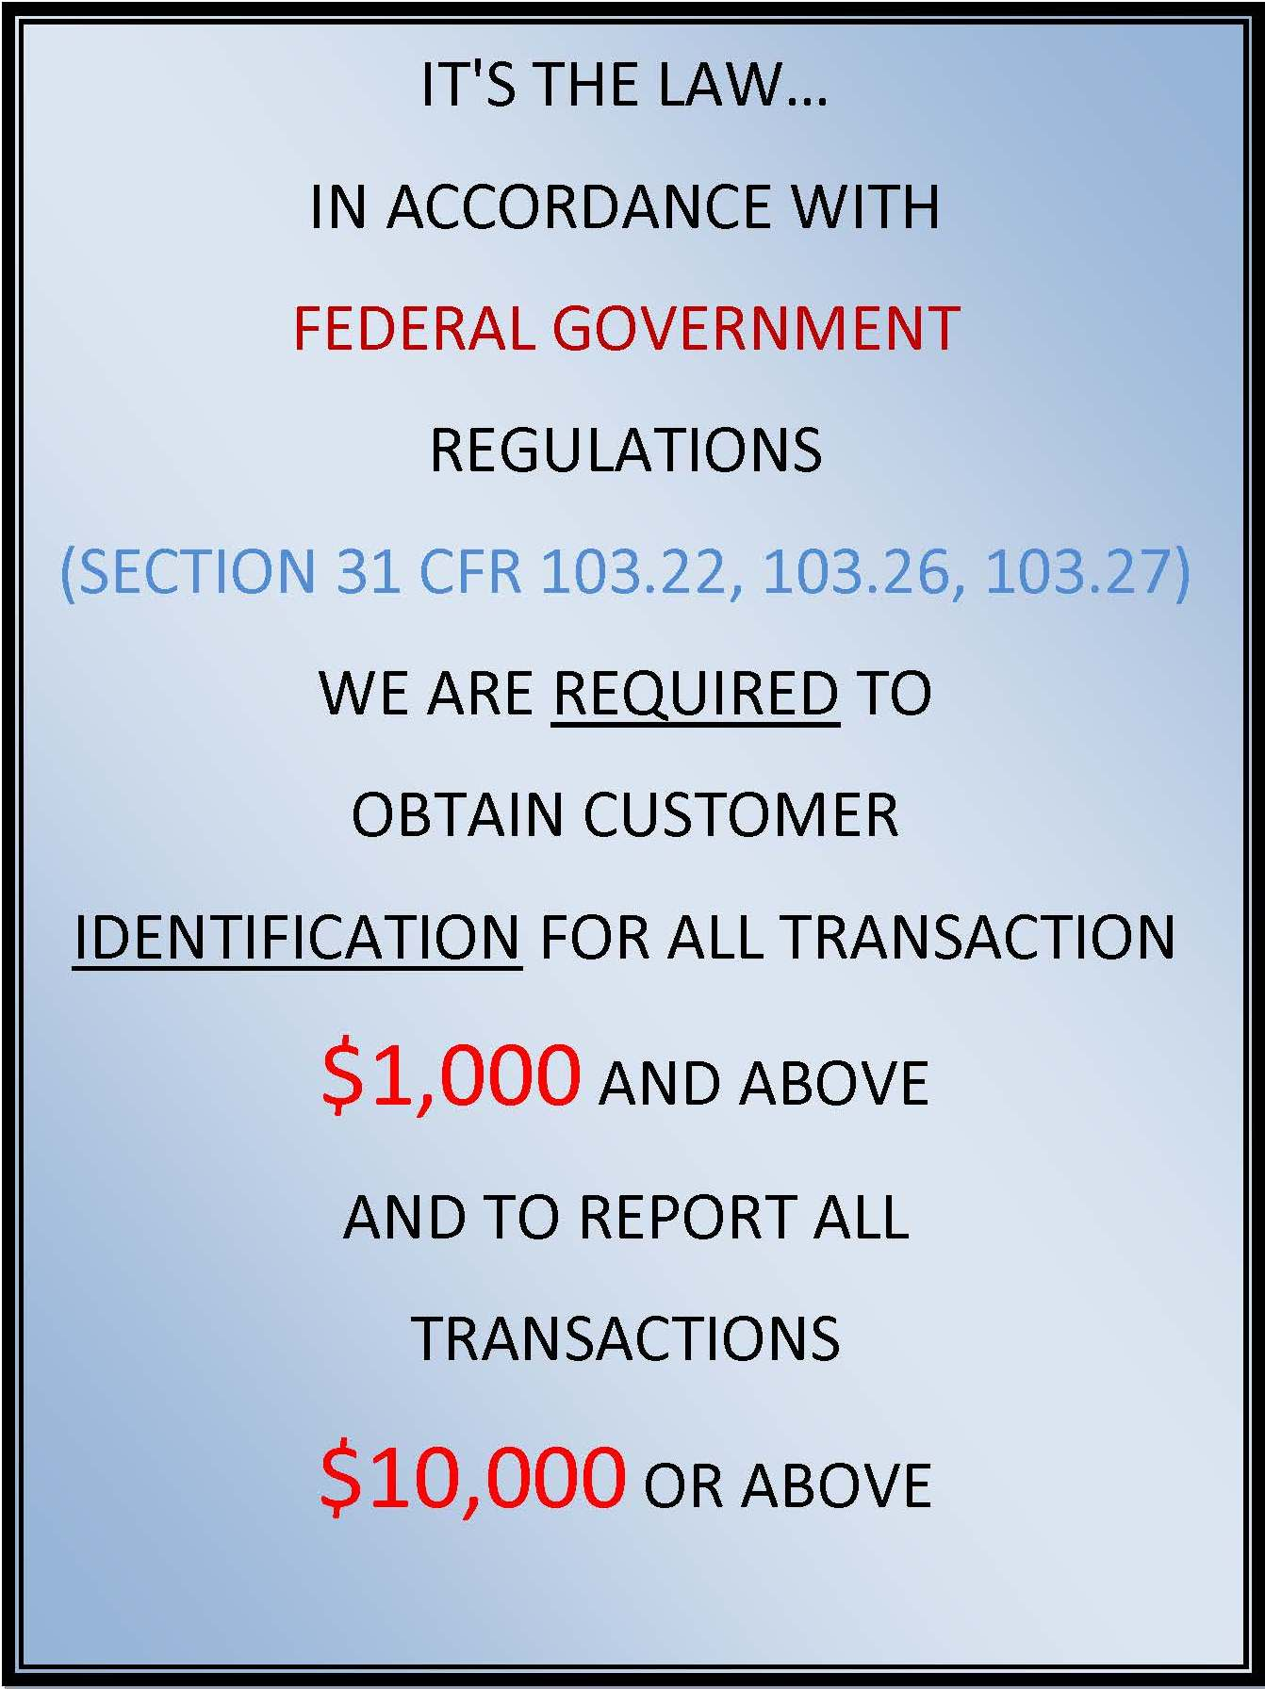
Federal law requirements

Slide 3
Identification required
U.S. Residents
World BNotes Exchange Inc. may ask for Driver’s License or Identification Card for any transaction below $1,000 USD as a company policy.
By law all: ( SECTION 31 CFR 103.22, 103.26, 103.27)
USD 1,000 or more
Driver’s License
Passport or social security (local residents)
USD 3,000 or over
Social security number/Passport
Driver’s License
Address of Residency
Occupation
Telephone number
USD 10,000
All fields are required plus the occupation

Slide 4
Identification required
Foreign Residents
USD 1,000 – 3,000
Passport
Home address
USD 3,000 – or over
Passport
Home address
Occupation
Telephone number
USD 10,000 – or over
CTR will be filed

Slide 5
WORLD BNOTES EXCHANGE INC.
AS A COMPANY POLICY WE ID ALL OF OUR CUSTOMERS UNDER $1,000
WE PRIDE OURSLEVES IN KNOWING WHO YOU ARE AND TO BETTER SERVE YOU!
WE LOOK FORWARD TO DOING BUSINESS WITH YOU!

